Slide 1
SECURE DATA HIDING IN IMAGES USING STEGANOGRAPHY
PROJECT TITLE
Presented By : Ravi Kumar
Student Name : Ravi Kumar
College Name : Bakhtiyarpur College of Engineering
Department : Computer Science & Engineering

Slide 2
OUTLINE
Problem Statement
Technology used
Wow factor
End users
Result
Conclusion
Git-Hub Link
Future scope

Slide 3
Problem Statement
In today’s digital age, the protection of sensitive data has become a critical concern due to the increasing frequency of cyber-attacks, unauthorized access, and theft. Traditional encryption methods can be detected, and there’s a need for more covert ways to hide information.
Steganography addresses this issue by concealing data within seemingly harmless files, such as images, audio, or video, making it nearly impossible to detect.

Slide 4
Technology used
Programming Language : Python
IDE : Either VS Code or Python IDLE
Libraries : openCV, os, string, tkinter, and pillow
Hardware : Intel i5 Processor , 8GB RAM
Operating System : Windows 11 Pro

Slide 5
Wow factors
GUI based Application: This Steganography application project offers Graphical User Interface (GUI) for input and output, facilitating better understanding of concept. It can be easily accessed by non-technical people also.
Invisible Data Transmission: Steganography allows users to send encrypted data without anyone realizing it, making it almost impossible to detect.
Multimedia Involvement: Information can be concealed in everyday files (images, audio, video), which people use all the time, creating an invisible layer of security.
Dual Security: Combining cryptography and steganography makes it an extra layer of protection, increasing security exponentially.

Slide 6
End users
Government & Military: For transmitting classified or sensitive information securely.
Banking Sector: To enhance security and protect sensitive information.
Cybersecurity Professionals: To hide files or messages to prevent interception.
Journalists & Activists: Used in repressive regimes to send secret information safely.
Digital Forensics Experts: To identify covert communication in digital media.
Individuals: To protect personal privacy or securely share confidential information.

Slide 7
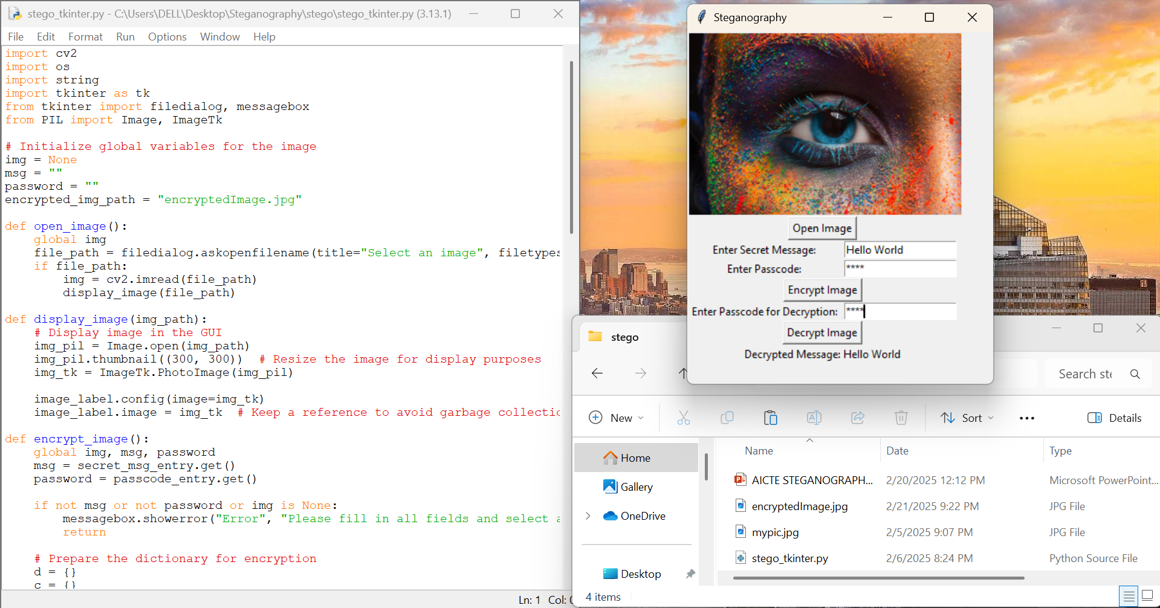
Results

Slide 8
Conclusion
Enhanced Security: Steganography plays a vital role in maintaining the confidentiality of information in a world where cybersecurity threats are increasingly common.
Unnoticed Protection: The ability to hide data in plain sight offers a unique advantage over traditional security measures like encryption alone.
Ethical Considerations: While it's useful for privacy and security, steganography can also be misused for malicious purposes (e.g., hiding illegal content), requiring responsible usage.

Slide 9
GitHub Link
Project Link : https://github.com/Ravi181kr/Steganography.git

Slide 10
Future scope
Advanced Techniques: Development of AI-based algorithms to make steganography more robust and undetectable.
Integration with Blockchain: Combining steganography with blockchain technology for enhanced security in transactions.
Real-time Steganography: Embedding data in live-streamed video and audio content for real-time covert communication.
Detection Tools: As steganography evolves, so will methods to detect and combat its use, leading to the creation of more sophisticated detection systems.
Legal and Ethical Frameworks: The growth of steganography will necessitate new laws and regulations to ensure its proper use, especially in preventing its misuse for illegal activities.

Slide 11
THANK YOU

